Slide 1
Big Mountain Resort
Ticket Price Modeling

Slide 2
Problem identification
How should Big Mountain Resort adjust its ticket price after the increase of operating costs of $1,540,000 this season? What changes should the resort consider in effort to either cut costs without undermining the ticket price or support an even higher ticket price?
How to select a better value for Big Mountain Resort ticket price?
The focus of this business initiative is to evaluate the various components of each facility and be able to create a robust pricing criteria.
To compensate for increasing operational cost, Big Mountain Resort pricing should not extend beyond the market range unless special amenities are offered in certain facilities.
Data Source: Single CSV file received from the database manager.

Slide 3
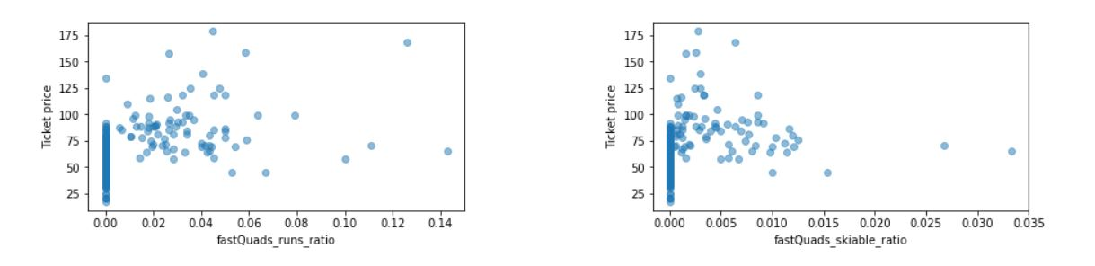
Recommendation and key findings
There was no significant pattern to the price distribution amongst states with respect to other features.
Having no fast quads may limit the ticket price, but if your resort covers a wide area then getting a small number of fast quads may be beneficial to ticket price.

Slide 4
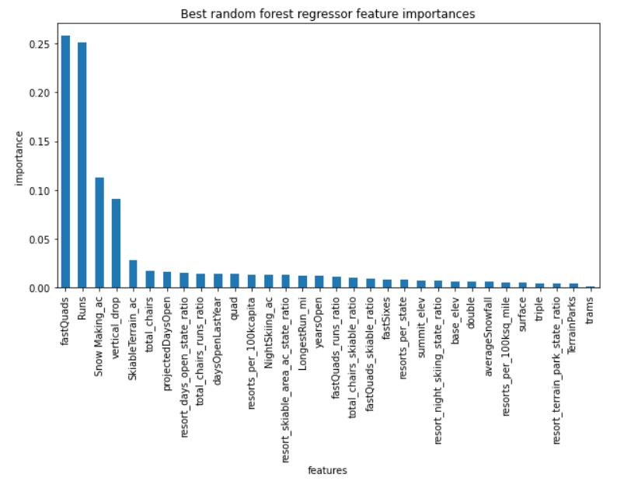
Modeling results and analysis
Feature importance is one of the
Key elements to construct a well
rounded and accurate model.
Using Random forest regression,
we landed a 70% measure of
accuracy.

Slide 5
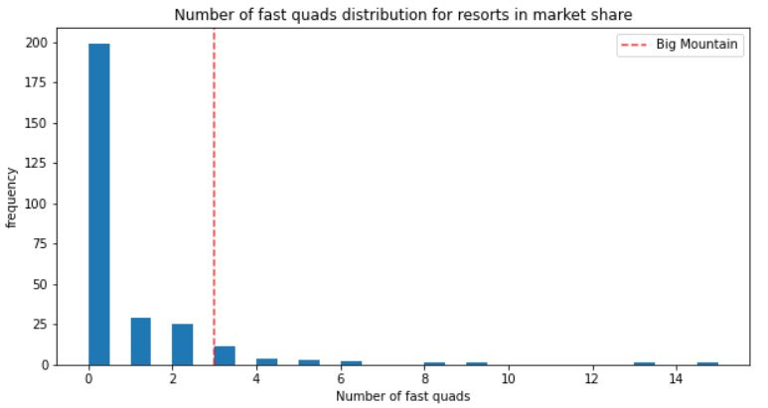
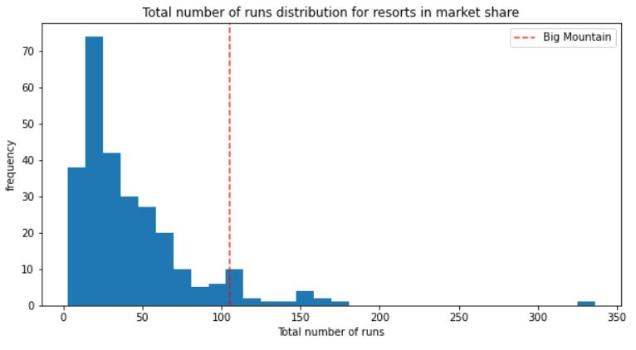
Modeling results and analysis
Most resorts have no fast quads. Big Mountain has 3, which puts it high up that league table
Big Mountain compares well for the number of runs.

Slide 6
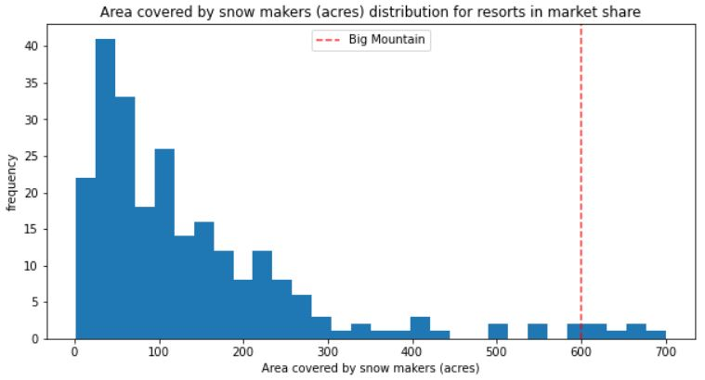
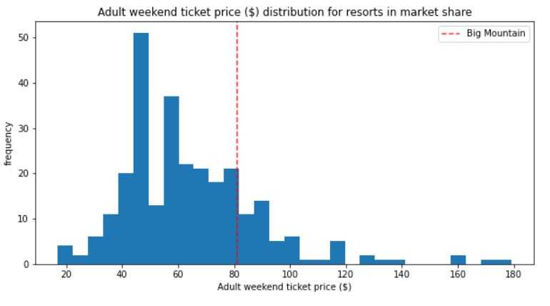
Modeling results and analysis
Big Mountain is very high up the league table of snowmaking area.
This is where Big Mountain sits amongst all resorts for price

Slide 7
Summary and conclusion
It is possible that Big Mountain underestimated its facilities in comparison to what other resorts have to offer with respect to their ticket price.
Based on the market value for tickets at other resorts, assuming that these locations have a good criteria for adjusting their prices based on the available features, our model suggests that big mountain can charge around $95 a ticket.
Big mountain should add $ 0.88 just to cover the new chair operational cost.

